Slide 1
Operation instruction manual
of SES system
Overseas business department agricultural equipment sales company
Service section
September, 2016

Slide 2
Catalogue
Chapter Ⅰ Instruction for basic functions
of SES system
Chapter Ⅱ Methods of querying illustration
books of parts and submitting orders
Chapter Ⅲ Inquiry methods of maintenance
manual
Chapter Ⅳ Solution of the frequent questions

Slide 3

Chapter Ⅰ Instruction for basic functions of SES system
Ⅰ、Landing method of SES
1、Website：Use IE browser, input the web address http:/ses.lovol.com
2、Sign in： Enter the login screen, input the user name and password.
Also input Username

Slide 4
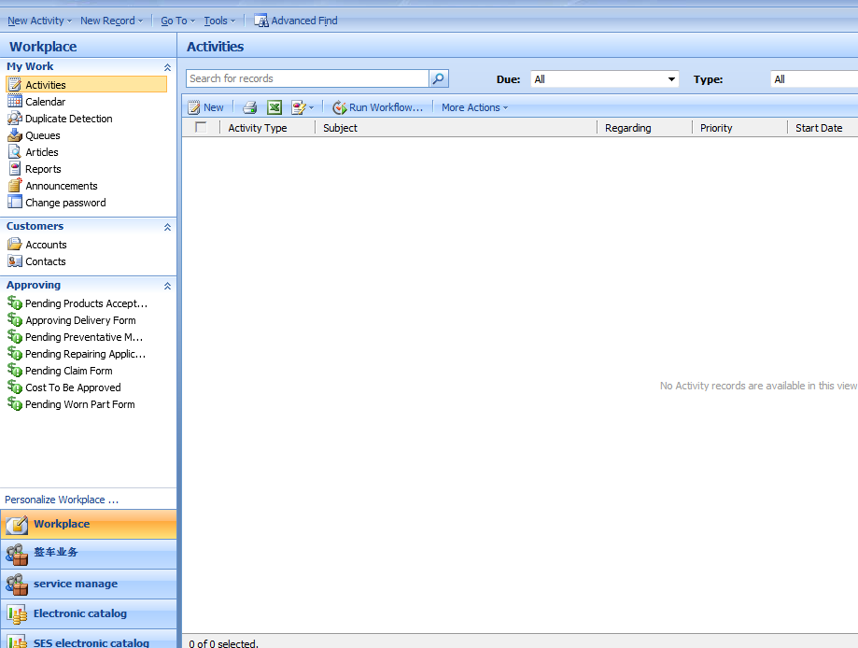
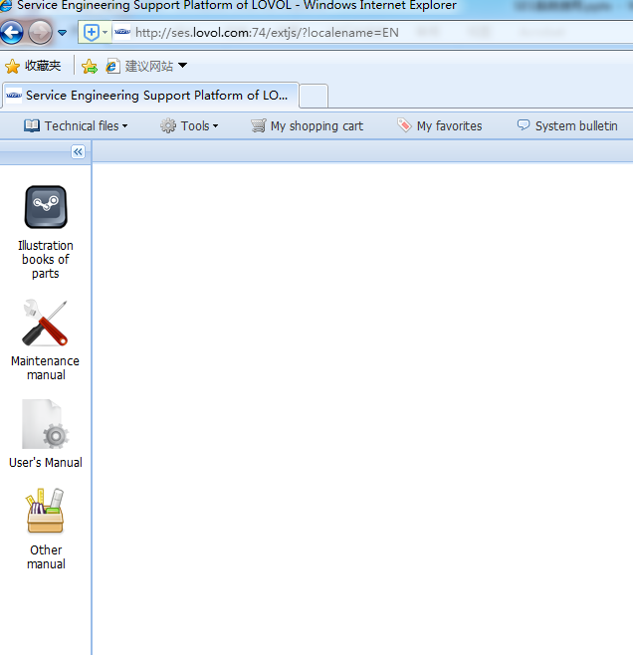

Chapter Ⅰ Instruction for basic functions of SES system
3、Enter SES system
Click “SES electronic catalog” then enter SES system after landing CRM.
Note：Click SES electronic catalog when it can not jump the SES page, please contact the part business personnel right away.
CRM page
SES page
Second step
Pages Turn
First step

Slide 5

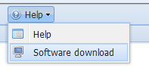
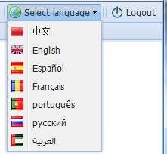
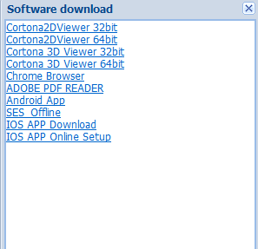
Chapter Ⅰ Instruction for basic functions of SES system
4、Initial setting of SES
(1)Select interface of language
(2)Install plug-in（ install 2D and 3D plug-in according to the computer operating system）.
Second step： Install plug-in
First step：Change language
Note：
1.You need to refresh the page
and login CRM again after installing plug-in.
2.The web page will pop a dialog box after landing, then click “allow”
3.Refresh the page finally, then can display the explosion diagram

Slide 6
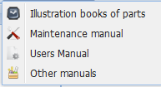

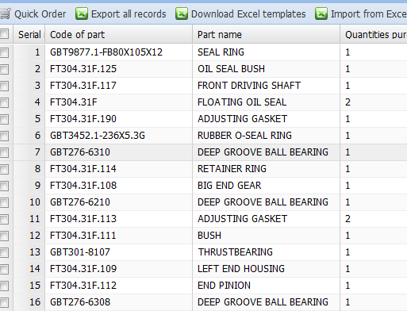
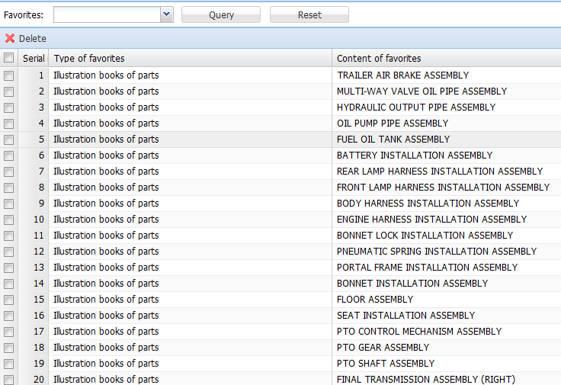
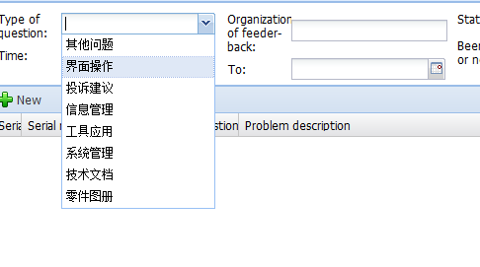
Chapter Ⅰ Instruction for basic functions of SES system
Ⅱ 、 Instruction for basic functions of SES system
Technical files Tools My shopping cart My favorites System bulletin
Information feedback Help
1、Technical information：Illustration books of parts、maintenance manual、operating instruction/manual of safety operation and maintenance、other manual.
2、Tools： query of installing files——Enter the VIN No. then can query the corresponding product resource No., engine code and list of parts, etc.
3、My shopping cart——We can purchase the parts of using illustration books of parts for querying, then form parts orders.
4、My favorites——Select manual, machine type number or Level 1 assembly number in
the technical documentation / manual list, click “favorites”.
5、System bulletin——Query bulletin information.
6、Information feedback——It can feedback problems of product, etc.
7、Help：Help、download——Plug-ins of SES system、SES of mobile version.
1
2
3
4
5
6
7

Slide 7
Catalogue
Chapter Ⅰ Instruction for basic functions
of SES system
Chapter Ⅱ Methods of querying illustration
books of parts and submitting orders
Chapter Ⅲ Inquiry methods of maintenance
manual
Chapter Ⅳ Solution of the frequent questions

Slide 8
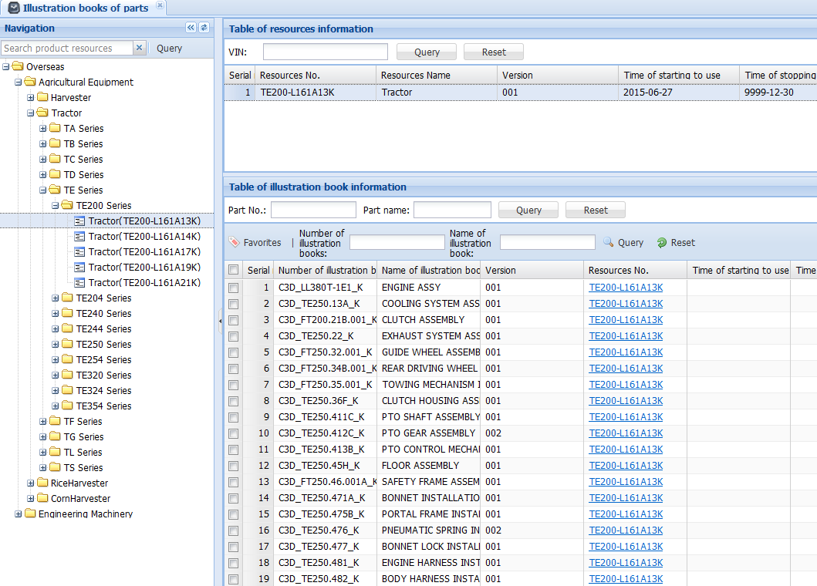
Chapter Ⅱ Methods of querying illustration books of parts and submitting orders
Ι、 Query illustration books of parts
1、Click “Illustration books of parts”, then enter the page of illustration books of parts, method of querying parts：
Query of expanding directory trees Query of researching resource No.
Query of inputting VIN No.
1
2
3
1.1 Query of expanding directory trees
First step：Click the directory tree on the left side in turn.
Note: In the case of not finding resources NO., it shows that the model is not developed, please contact the business personnel right away, for developing it in targeted
Third step：Double-click resource No.
Second step：Double-click resource No.
Fourth step：Double-click and then enter explosion diagram of assembly

Slide 9
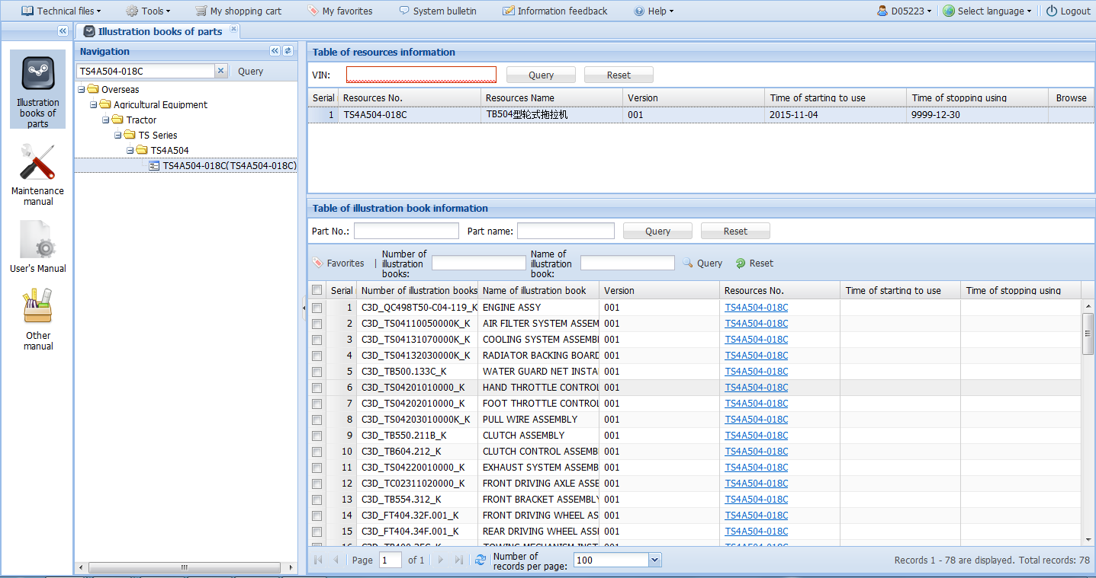
Chapter Ⅱ Methods of querying illustration books of parts and submitting orders
Ι、 Query illustration books of parts
Note: In the case of resource NO. is correct, when it can not search a resource normally, please contact the spare parts business personnel, as this model is not developed.
1.2 Query of researching resource No.
Can be filled with fuzzy, not case-insensitive. For example：TB /Tb
First step：Enter resource No.
Third step：Double-click resource No.
Second step：Double-click resource No.
Description: Double-click resource No. then go into the list, select the Level 1 assembly that is needed to query ,then click it and go into the total explosion map page
Fourth step：Double-click and then enter explosion diagram of assembly

Slide 10
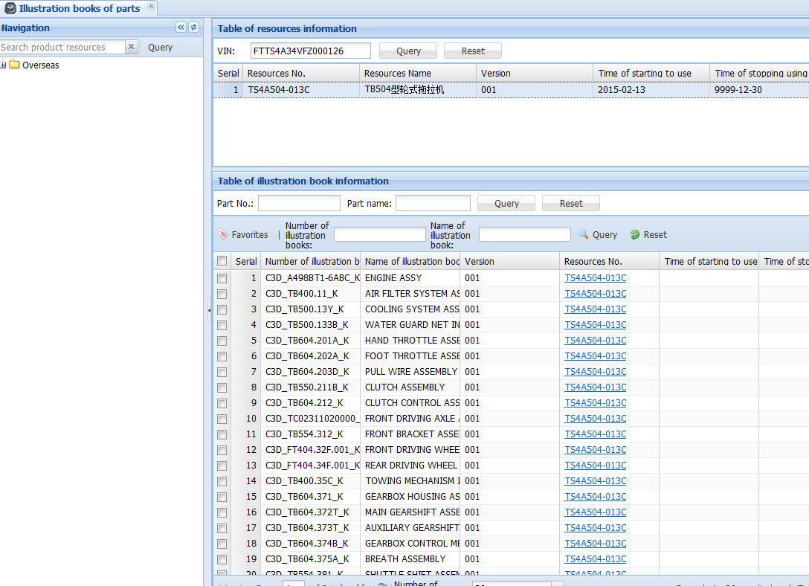
Chapter Ⅱ Methods of querying illustration books of parts and submitting orders
Ι、 Query illustration books of parts
Note: In the case of the number of VIN is correct, when it can not search a resource normally, please contact the spare part business personnel right away, as this model is not maintained.
1.3 Query of inputting VIN No.
The correct VIN No., case-insensitive.
First step：Enter VIN No.
Second step：Double-click machine type No.
Third step：Double-click then enter the explosion diagram of assembly

Slide 11
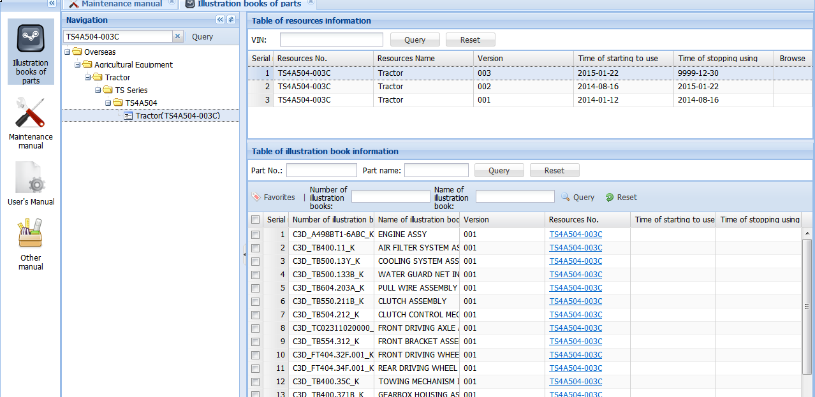
Chapter Ⅱ Methods of querying illustration books of parts and submitting orders
Ι、 Query illustration books of parts
2、Select model version
If you encounter many versions of one model，please select the suitable version for whole machine and query according to time of starting to use and time of stopping to use.
Note the relationship between time of starting to use and time of stopping to use.

Slide 12
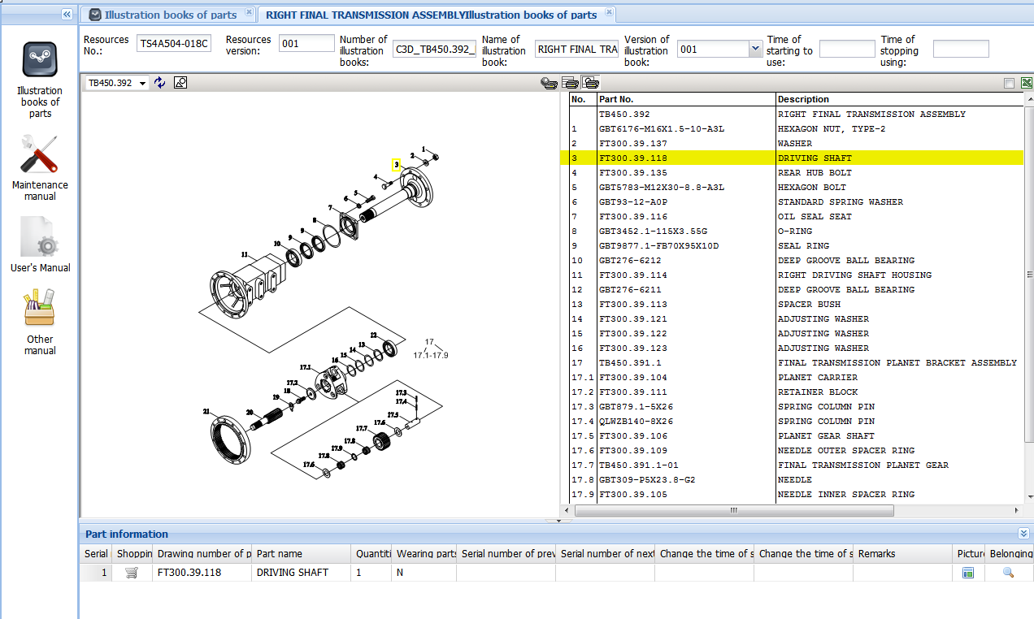
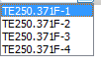
Chapter Ⅱ Methods of querying illustration books of parts and submitting orders
Ι、 Query illustration books of parts
3、Query of explosion diagram and schedule.
（1）When it does not display explosion diagram， click on .If it still does not display, please install 2D application according to process for the first part.
（2）Double-click “Part No”. then select parts ，it display the information of parts on “Parts information”（If the information can not display ，it means that it can not be provided. In this case, you need to submit materials of the previous level or consult personnel of parts orders).
（3） The relationship between callout and part No. is corresponding. When you select callout or part NO.it displays yellow .（as shown below）
Change pictures
corresponding

Slide 13
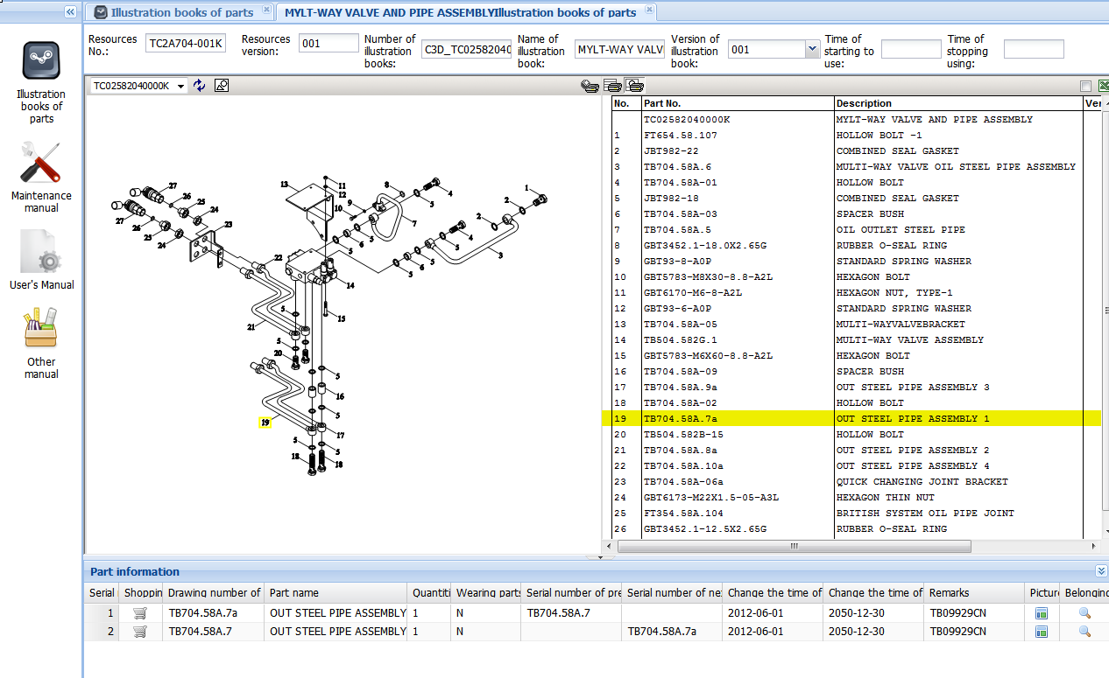
Chapter Ⅱ Methods of querying illustration books of parts and submitting orders
Ι、 Query illustration books of parts
4、Change of the part status.
When you double-click the required part NO. If the part status has been changed, it will display the change information in“ Part information”（ as shown below ）.
Note：Please pay attention to the time of starting to use and time of stopping to use when you submit part order.
The current part NO.
The previous part NO.
The next part NO.
Enable time
Down time

Slide 14

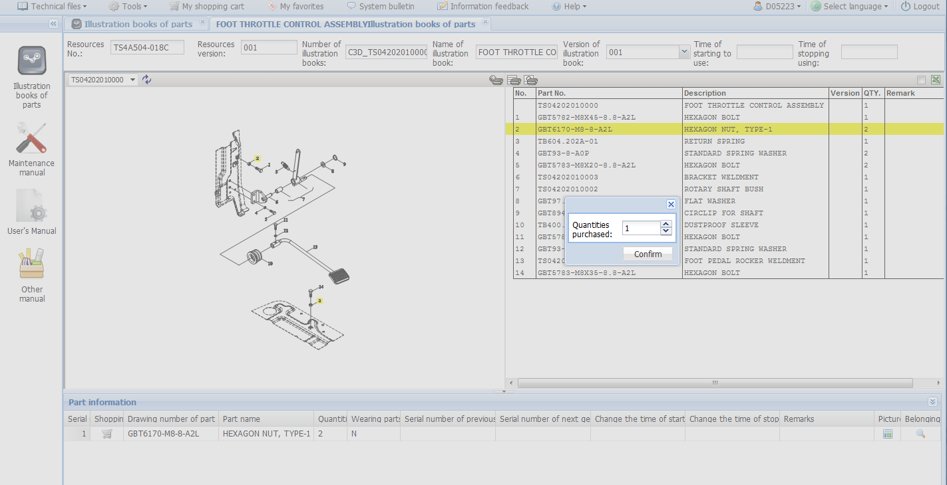
Chapter Ⅱ Methods of querying illustration books of parts and submitting orders
Ⅱ 、The process of submitting part order
1、after double-clicking the parts No.，click it and add it to shopping chart the in “Part information”， then it will prompt purchase quantity ， and then select purchase quantity.
Note：If it has the change of status parts, you can order other status parts.
the first step
Double-click the part NO.
Select part NO.
The third step
Select purchase quantity
Second step
Add it to shopping chart
Loading quantity

Slide 15
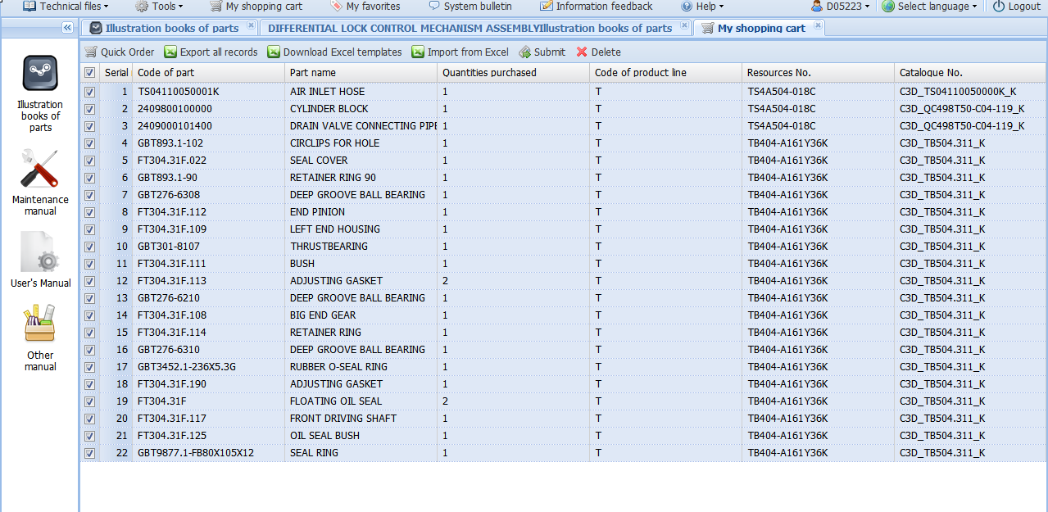
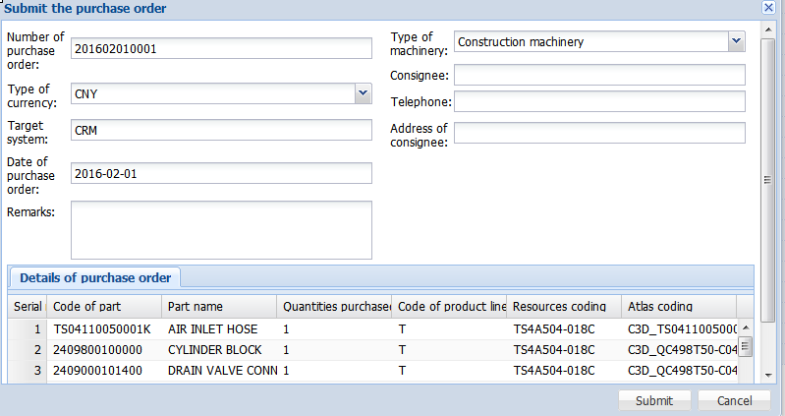

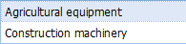
Chapter Ⅱ Methods of querying illustration books of parts and submitting orders
Ⅱ 、 The process of submitting part order
2、Enter into“ My shopping cart”after selecting the required parts. Reconfirm the required parts and submit part order.
3、It will pop dialog box after submitting, you need to fill out the information of purchase part dealer faithfully. If the order is finished , please stop the operation
1
3
Submit part order
2
Selecting parts
4
Note: You have to fill out the information of dealer faithfully then submit it.
5
Revise part order quantity finally
6

Slide 16
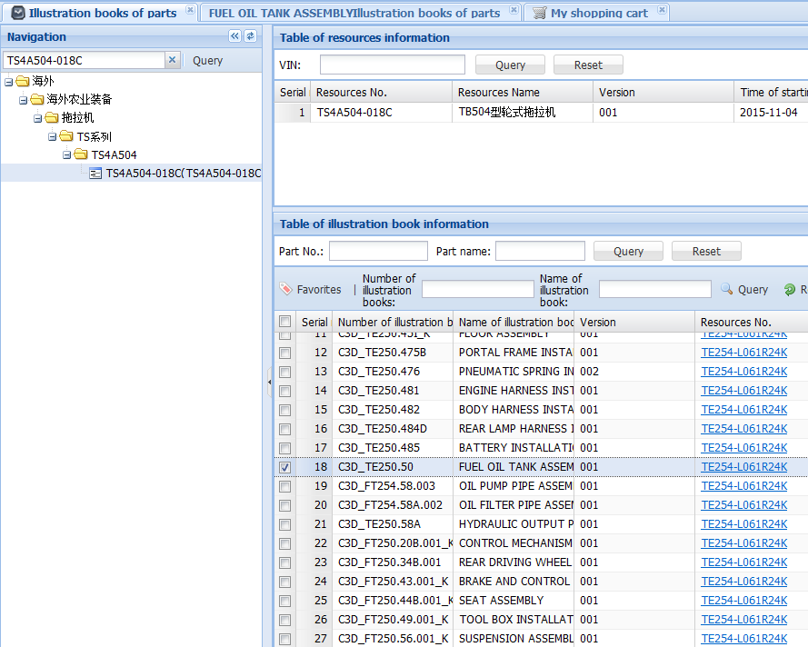
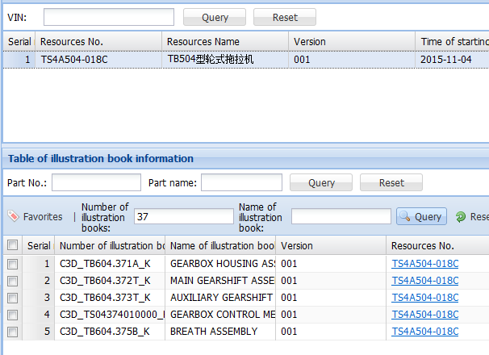
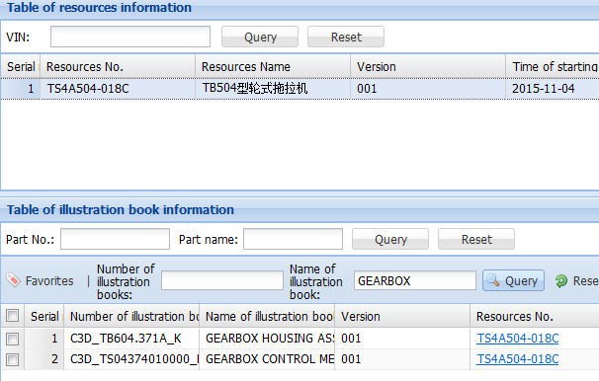
Chapter Ⅱ Methods of querying illustration books of parts and submitting orders
Ⅲ、Other function
1、Searching of single resource
After searching for Level 1 assembly according to Resource No. or VIN ，and then you input grouping of illustration books NO. and name of illustration books alone, or input both of them ，you can query the corresponding level 1 assembly in these ways .
Use resource NO. to query original status
Input part No. to query
Note：you have to input the correct part NO. to search, specific part No. can be seen on attachment
Input resources name to query
Note： Searching for a single word must be accurate and complete

Slide 17
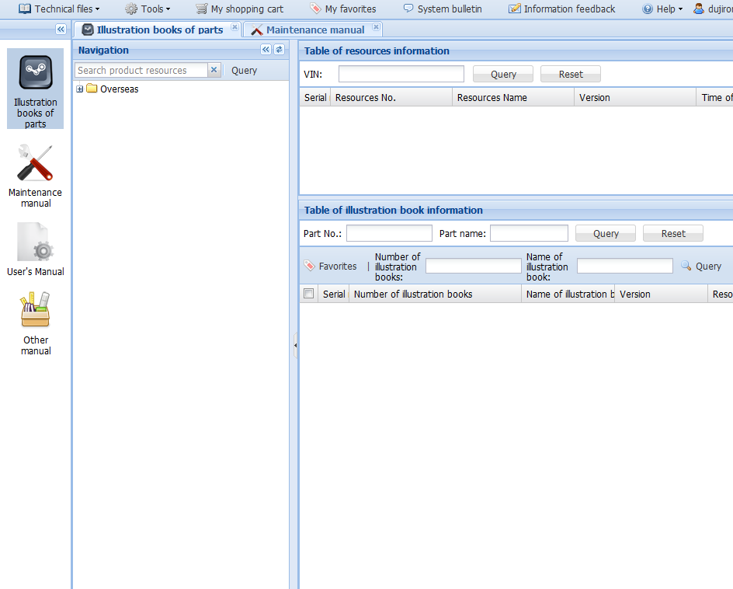
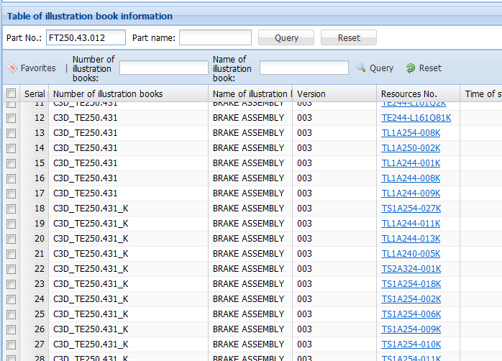
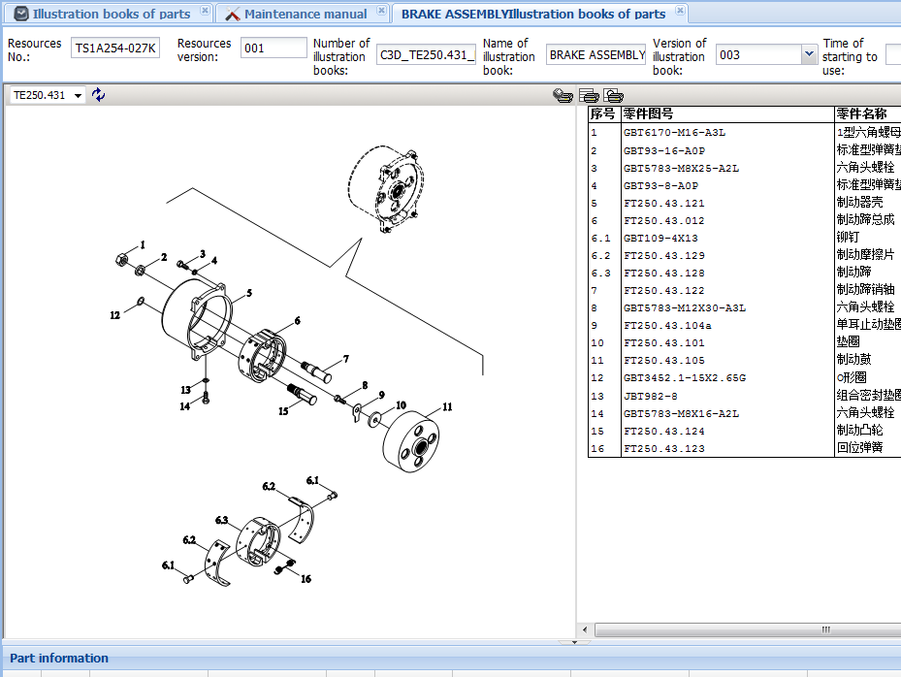
Chapter Ⅱ Methods of querying illustration books of parts and submitting orders
Ⅲ、Other function
2、Query part NO. reversely
Click “Illustration books of parts “ into its screen, then query resource and level 1 assembly through part NO. that is to say ,input accurate part NO. in “Part NO.”, then you can query related the level 1 assembly and resource NO.
Click “Illustration books of parts” button into it
Part No. must be correct (case-insensitive)
Input part No. to query
2
3
1
4
Contain level 1 assembly of part
The corresponding resource No.
5
The corresponding explosion diagram
Note：
Without any operation, input the correct part No to query directly .

Slide 18
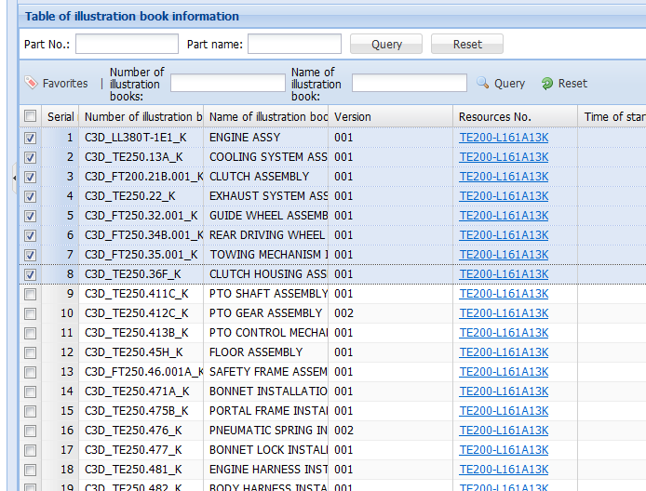
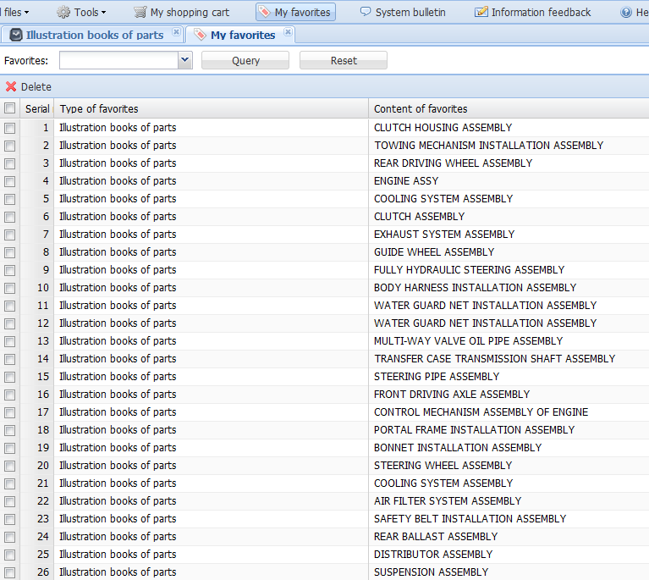
Chapter Ⅱ Methods of querying illustration books of parts and submitting orders
Ⅲ、Other function
3、Add level 1 assembly to favorites
Firstly ,you should select level 1 assembly that you need to collect ,and then add what you select to “Favorites”.
3
2
1

Slide 19
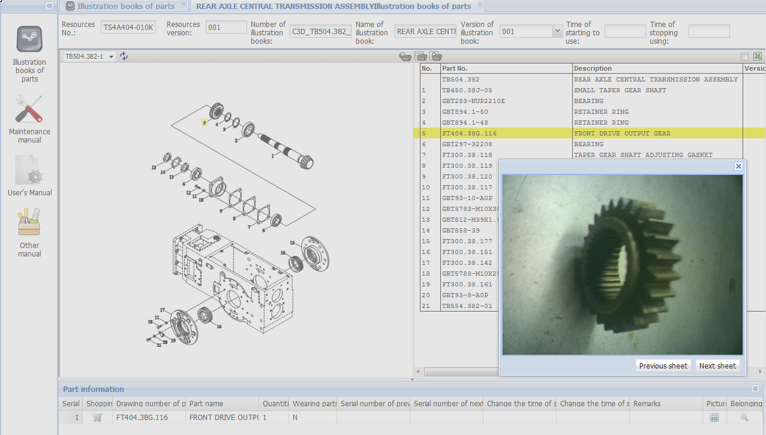
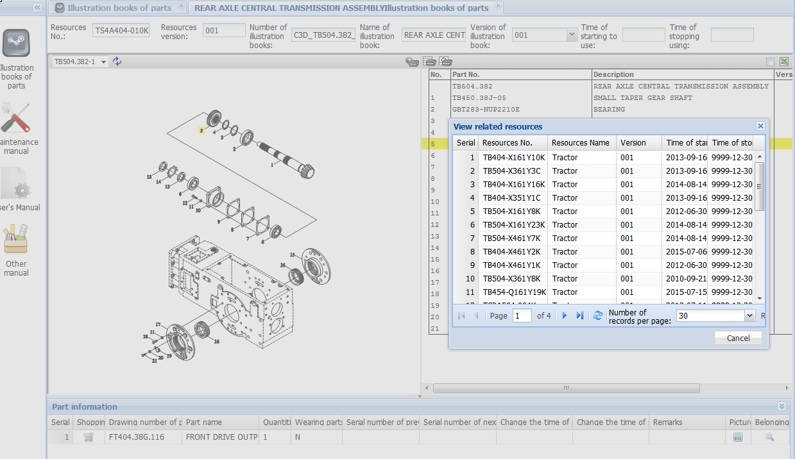
Chapter Ⅱ Methods of querying illustration books of parts and submitting orders
Ⅲ、Other function
4、Query physical drawing and resource reversely
A. Click the in the right corner after you select Part No.，and then the physical drawing will be displayed.
B. Click “Belonging-to resources icon” ，and all the parts resources will be displayed.
A
B
Model display area
The physical picture display area

Slide 20
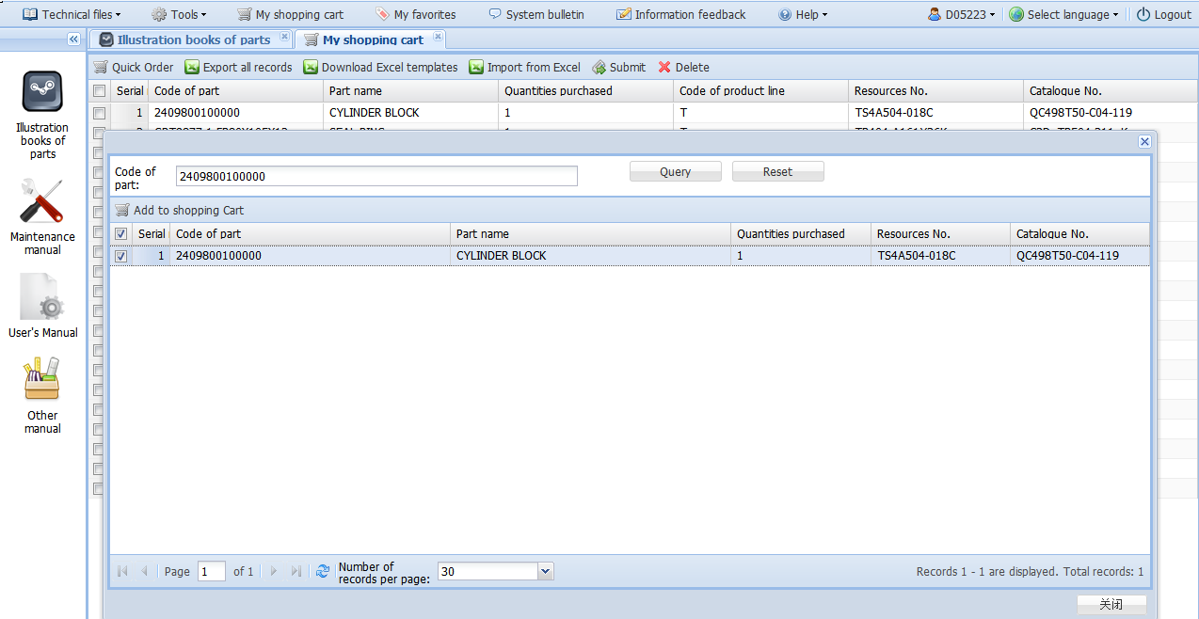
Chapter Ⅱ Methods of querying illustration books of parts and submitting orders
Ⅲ、Other function
5、Order parts quickly
Enter my shopping cart, select the “quick order”. Input part NO. to query. Quick order need to input quantity, model number, level 1 assembly NO. manually and make sure that the order status is documented.
1
2
6
Parts choose success
3
5
After input number, select parts and add a shopping cart. My shopping cart shows the part information. Complete the query
4
To manually enter the quantity, model number, level 1 assembly.
Function 1 ：
The function can search intangibly , not case-insensitive.
Function 2：
Output all parts lists of shopping cart.
Function 3：
Download system version, make parts order and input system according to the version.

Slide 21
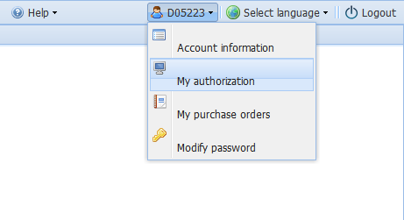
Chapter Ⅱ Methods of querying illustration books of parts and submitting orders
三、other function
6、query the submitted order
click in upper right corner on the page, you can query my purchase orders.

Slide 22
Chapter Ⅱ Methods of querying illustration books of parts and submitting orders
Attachment：part schedule of tractor
P/N | English Name |  | P/N | English Name
10 | FLYWHEEL INSTALLATION ASSEMBLY |  | 32 | FRONT WHEEL ASSEMBLY
11 | AIR FILTER SYSTEM ASSEMBLY |  | 32 | GUIDE WHEEL ASSEMBLY
11 | AIR FILTER ASSEMBLY |  | 32 | FRONT DRIVING WHEEL ASSEMBLY
13 | COOLING SYSTEM ASSEMBLY |  | 34 | REAR DRIVING WHEEL ASSEMBLY
13.1 | COOLING SYSTEM ASSEMBLY |  | 34 | DRIVING WHEEL ASSEMBLY
13.2 | BRACKET INSTALLATION ASSEMBLY |  | 35 | TOWING MECHANISM INSTALLATION ASSEMBLY
13.3 | WATER TANK SEAL PLATE |  | 36 | CLUTCH HOUSING ASSEMBLY
20 | CONTROL MECHANISM ASSEMBLY OF ENGINE |  | 36 | CLUTCH HOUSING SUBASSEMBLY
20 | EXTINGUISH WIRE ASSEMBLY |  | 36.1 | SHUTTLE SHIFT ASSEMBLY
20.1 | HAND THROTTLE CONTROL MECHANISM |  | 36.1 | CREEPER GEAR ASSEMBLY
20.1 | HAND THROTTLE ASSEMBLY |  | 36.1 | SHUTTLE SHIFT ASSEMBLY
20.1 | HAND THROTTLE,FLAMEOUT CABLE ASSEMBLY |  | 36.1 | CLUTCH HOUSING ASSEMBLY
20.2 | FOOT THROTTLE ASSEMBLY |  | 36.2 | SHUTTLE SHIFT CONTROL MECHANISM ASSEMBLY
20.3 | PULL WIRE ASSEMBLY |  | 36.2 | CREEPER GEAR CONTROL MECHANISM ASSEMBLY
21 | CLUTCH ASSEMBLY |  | 37 | TRANSMISSION CASE ASSEMBLY
21 | CLUTCH SUBASSEMBLY |  | 37 | RIGHT HALF SHAFT ASSEMBLY
21.2 | CLUTCH CONTROL ASSEMBLY |  | 37 | LEFT HALF SHAFT ASSEMBLY
22 | EXHAUST SYSTEM ASSEMBLY |  | 37.2 | REAR CENTRAL ASSEMBLY OF TRANSMISSION CASE
24 | BATTERY INSTALLATION ASSEMBLY |  | 37.3 | TRANSMISSION CASE CONTROL MECHANISM ASSEMBLY
31 | FRONT AXLE ASSEMBLY |  | 39.1 | FINAL TRANSMISSION ASSEMBLY (LEFT)
31 | FRONT DRIVING AXLE ASSEMBLY |  | 39.2 | FINAL TRANSMISSION ASSEMBLY (RIGHT)
31 | FRONT DRIVING AXLE SUB-ASSEMBLY |  | 40 | MECHANICAL STEERING GEAR ASSEMBLY
31.1 | FRONT SHAFT ASSEMBLY |  | 40 | STEERING WHEEL ASSEMBLY
31.2 | BRACKET ASSEMBLY |  | 40 | FULLY HYDRAULIC STEERING ASSEMBLY
31.3 | FRONT SUPPORT SEAT ASSEMBLY |  | 40.2 | STEERING PIPE ASSEMBLY
31.4 | REAR SUPPORTING SEAT ASSEMBLY |  | 40.3 | ADJUSTING STEERING COLUMN INSTALLATION ASSEMBLY

Slide 23
Chapter Ⅱ Methods of querying illustration books of parts and submitting orders
Attachment：part schedule of tractor
P/N | English Name |  | P/N | English Name
40.3 | STEERING PIPE COLUMN ASSEMBLY |  | 45.7 | FRONT CONNECTING ASSEMBLY
40.3 | STEERING COLUMN MOUNTING ASSEMBLY |  | 45.8 | REAR CONNECTING ASSEMBLY
40.3 | STEERING COLUMN INSTALLATION |  | 46 | SAFETY FRAME ASSEMBLY
41 | PTO ASSEMBLY |  | 47 | BONNET MUDGUARD ASSEMBLY
41.1 | PTO SHAFT ASSEMBLY |  | 47 | BONNET INSTALLATION ASSEMBLY
41.2 | PTO GEAR ASSEMBLY |  | 47 | DASHBOARD INSTALLATION ASSEMBLY
41.3 | PTO CONTROL MECHANISM ASSEMBLY |  | 47.1 | BONNET ASSEMBLY
42 | TRANSFER CASE ASSEMBLY |  | 47.3 | REARVIEW MIRROR INSTALLATION ASSEMBLY
42.1 | TRANSFER CASE HOUSING ASSEMBLY |  | 47.3 | BONNET SEAL INSTALLATION ASSEMBLY
42.2 | TRANSFER CASE TRANSMISSION ASSEMBLY |  | 47.3 | FRONT MUD GUARD INSTALLATION ASSEMBLY
42.2 | TRANSFER CASE TRANSMISSION SHAFT ASSEMBLY |  | 47.4 | DASHBOARD ASSEMBLY
42.3 | TRANSFER CASE CONTROL ASSEMBLY |  | 47.5 | PORTAL FRAME INSTALLATION ASSEMBLY
43 | BRAKE AND CONTROL MECHANISM |  | 47.6 | PNEUMATIC SPRING INSTALLATION ASSEMBLY
43.1 | BRAKE ASSEMBLY |  | 47.6 | BONNET PNEUMATIC SPRING INSTALLATION ASSEMBLY
43.3 | BRAKE CONTROL MECHANISM ASSEMBLY |  | 47.7 | BONNET LOCK INSTALLATION ASSEMBLY
43.3 | BRAKE CONTROL ASSEMBLY |  | 48 | ELECTRIC SYSTEM ASSEMBLY
43.3 | BRAKE SYSTEM CONTROL ASSEMBLY |  | 48 | INSTRUMENT HARNESS AND ACCESSORIES ASSEMBLY
44 | SEAT INSTALLATION ASSEMBLY |  | 48 | MAIN HARNESS AND FRONT LAMP ASSEMBLY
44 | SEAT ASSEMBLY |  | 48 | REAR LAMP HARNESS INSTALLATION ASSEMBLY
45 | FLOOR ASSEMBLY |  | 48 | INSTRUMENT ASSEMBLY
45 | FLOOR INSTALLATION ASSEMBLY |  | 48.1 | ENGINE HARNESS INSTALLATION ASSEMBLY
45.2 | FENDER MOUNTING ASSEMBLY |  | 48.2 | BODY HARNESS INSTALLATION ASSEMBLY
45.3 | PEDAL INSTALLATION ASSEMBLY |  | 48.2 | BODY HARNESS ASSEMBLY
45.4 | FLOOR MUDGUARD INSTALLATION ASSEMBLY |  | 48.3 | FRONT LAMP HARNESS INSTALLATION ASSEMBLY
45.5 | DRIVER’S CAB ASSEMBLY |  | 48.7 | INSTRUMENT MOUNTING ASSEMBLY
45.5 | DRIVER'S CAB INSTALLATION ASSEMBLY |  | 48.7 | COMBINED INSTRUMENT ASSEMBLY

Slide 24
Chapter Ⅱ Methods of querying illustration books of parts and submitting orders
Attachment：part schedule of tractor
P/N | English Name |  | P/N | English Name
49 | TOOL BOX INSTALLATION ASSEMBLY |  | 58 | OIL FILTER PIPE ASSEMBLY
49 | TOOL BOX ASSEMBLY |  | 58 | HYDRAULIC OUTPUT PIPE ASSEMBLY
50 | FUEL OIL TANK ASSEMBLY |  | 58.1 | OIL PUMP/PIPE/FILTER ASSEMBLY
50 | OIL TANK INSTALLATION ASSEMBLY |  | 58.2 | HYDRAULIC LIFTING OIL PIPE ASSEMBLY
50.1 | OIL TANK ASSEMBLY |  | 58.3 | SINGLE-WAY HYDRAULIC OUTPUT ASSEMBLY 1
50.3 | OIL CONVEYING PIPE ASSEMBLY |  | 58.3 | SIMPLE HYDRAULIC OUTPUT INSTALLATION ASSEMBLY
53 | TOW EQUIPMENT ASSEMBLY |  | 62 | SAFETY BELT INSTALLATION ASSEMBLY
53 | TOW EQUIPMENT INSTALLATION ASSEMBLY |  | 62 | SAFETY BELT ASSEMBLY
55 | LIFTER ASSEMBLY |  | 63 | FRONT LOADING OIL TANK AND PIPE ASSEMBLY
55 | LIFTER INSTALLATION ASSEMBLY |  | 74 | FRONT BALLAST ASSEMBLY
55 | BREATH ASSEMBLY |  | 74 | FRONT BALLAST BRACKET ASSEMBLY
55 | FRONT LOADING CONNECTING PIPE ASSEMBLY |  | 74.2 | BALLAST ASSEMBLY
55.6 | AUXILIARY OIL TANK ASSEMBLY |  | 80 | TRAILER AIR BRAKE ASSEMBLY
55.6 | HYDRAULIC AUXILIARY OIL TANK ASSEMBLY |  | 80.1 | AIR CYLINDER INSTALLATION ASSEMBLY
56 | SUSPENSION ASSEMBLY |  | 80.1 | BRAKE VALVE ASSEMBLY
57 | DISTRIBUTOR ASSEMBLY |  | 80.2 | PNEUMATIC BRAKE PIPE ASSEMBLY
57 | DISTRIBUTOR AND CONTROL MECHANISM ASSEMBLY |  | 80.2 | AIR CYLINDER ASSEMBLY
58 | MULTI-WAY VALVE OIL PUMP ﹠ OIL PIPE ASSEMBLY |  | 80.3 | AIR CONVEYING PIPELINE ASSEMBLY
58 | MULTI-WAY VALVE OIL PIPE ASSEMBLY |  | 81 | HEATER INSTALLATION ASSEMBLY
58 | OIL PUMP PIPE ASSEMBLY |  | 91 | REAR BALLAST ASSEMBLY

Slide 25
Catalogue
Chapter Ⅰ Instruction for basic functions
of SES system
Chapter Ⅱ Methods of querying illustration
books of parts and submitting orders
Chapter Ⅲ Inquiry methods of maintenance
manual
Chapter Ⅳ Solution of the frequent questions

Slide 26
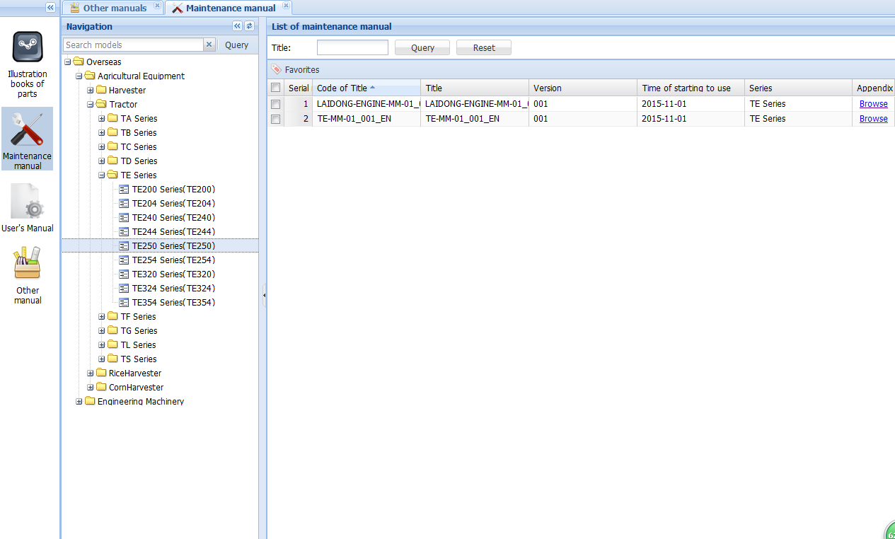
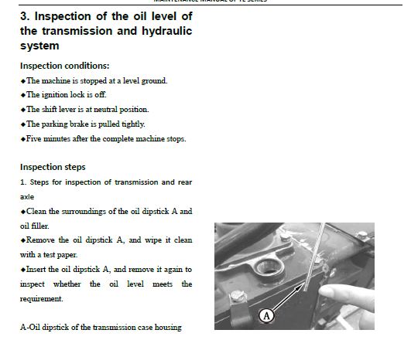
Chapter Ⅲ Inquiry methods of maintenance manual
Ⅰ 、 The method of manual query
Maintenance manuals, specifications and other manuals are the same query just like the following two ways :
Query of directory tree Query of fuzzy search
1
2
1.1、 Query of directory tree
2
1
4
3
5
Separate PDF file

Slide 27
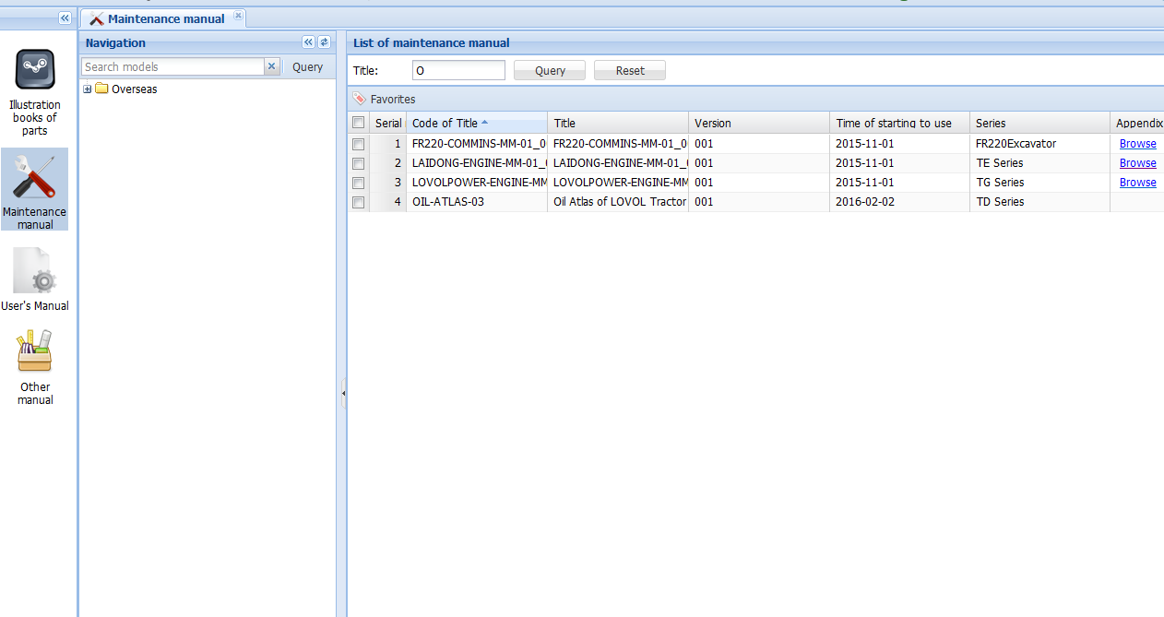
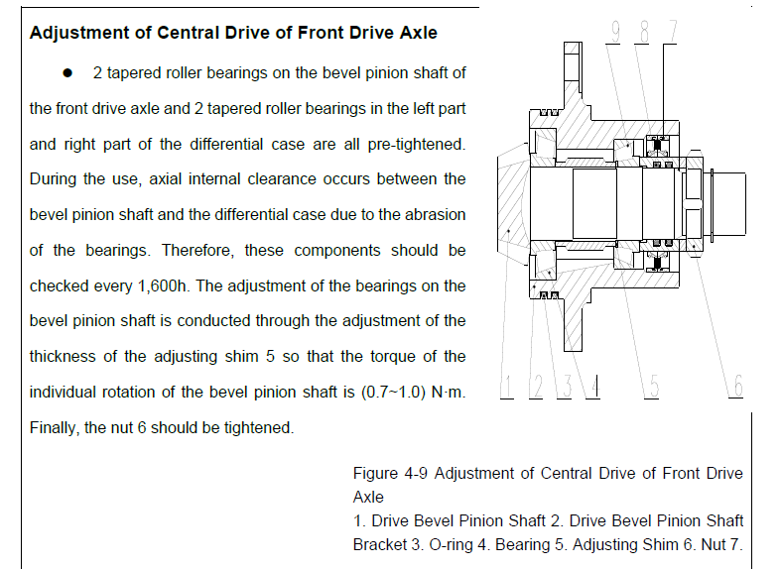
Chapter Ⅲ Inquiry methods of maintenance manual
Ⅰ 、 The method of manual query
1.2、 Query of fuzzy search
1、Click repair manual, the manual list will appear on the right side.
2、Search the content of manual topic intangibly.
3、Click browse then open and check it in SES system .
2
Fuzzy search
3
1
4
Separate PDF file

Slide 28
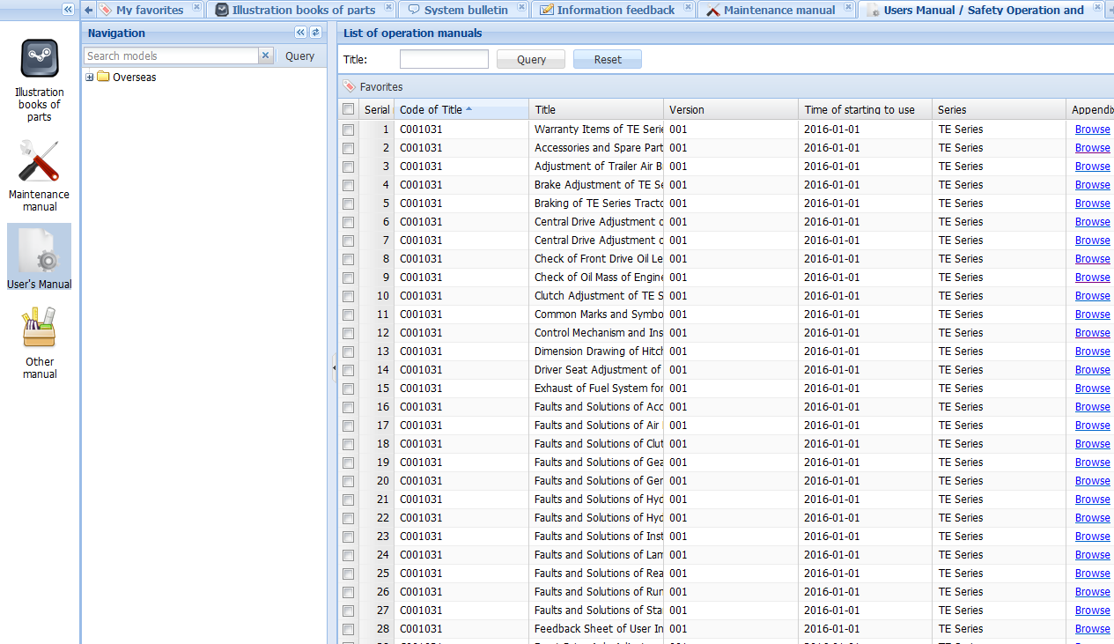
Chapter Ⅲ Inquiry methods of maintenance manual
Ⅱ 、The method of specification query
Note: the query method is the same with maintenance manual.
1、Click specification, the manual list will appear on the right side.
2、Search the content of manual topic intangibly.
3、Click browse then open and check it in SES system .
2
Fuzzy search
1
3
4
Separate PDF files

Slide 29
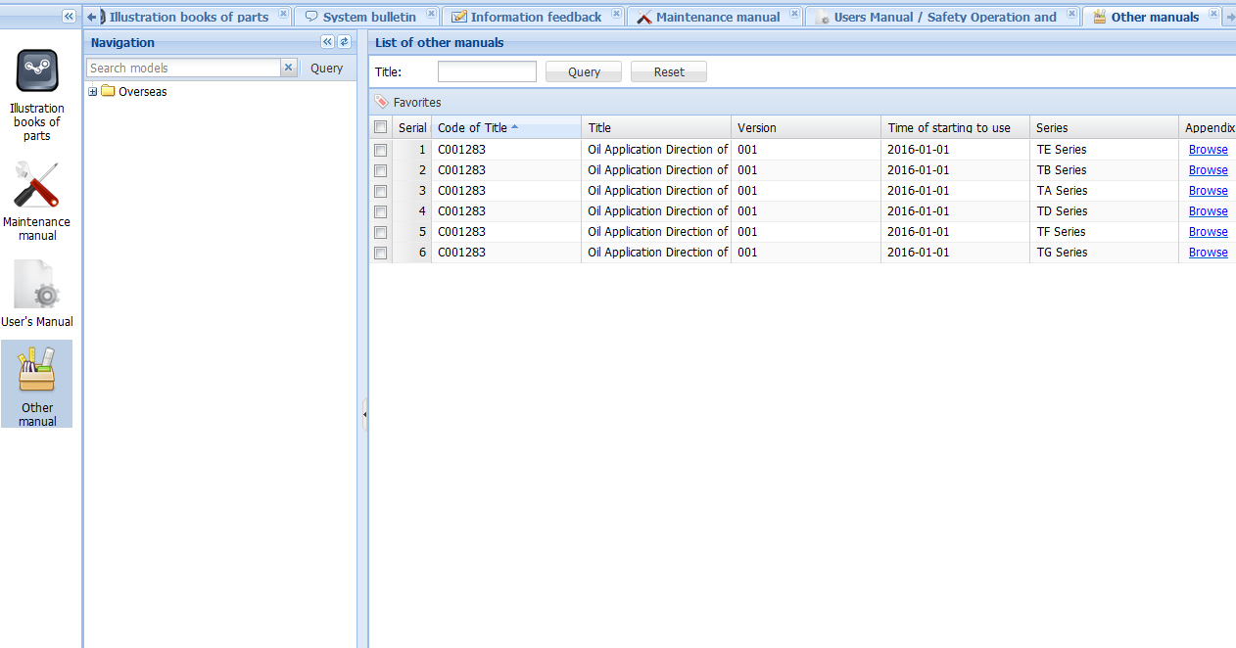
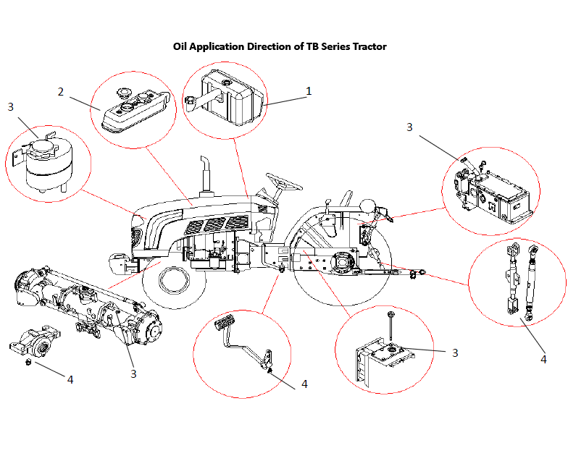
Chapter Ⅲ Inquiry methods of maintenance manual
Ⅲ 、The method of other manual query
Note: the query method is the same with maintenance manual.
1、Click other manual , the manual list will appear on the right side.
2、Search the content of manual topic intangibly.
3、Click browse then open and check it in SES system .
2
Fuzzy search
3
4
Separate PDF files
1

Slide 30
Catalogue
Chapter Ⅰ Instruction for basic functions
of SES system
Chapter Ⅱ Methods of querying illustration
books of parts and submitting orders
Chapter Ⅲ Inquiry methods of maintenance
manual
Chapter Ⅳ Solution of the frequent questions

Slide 31
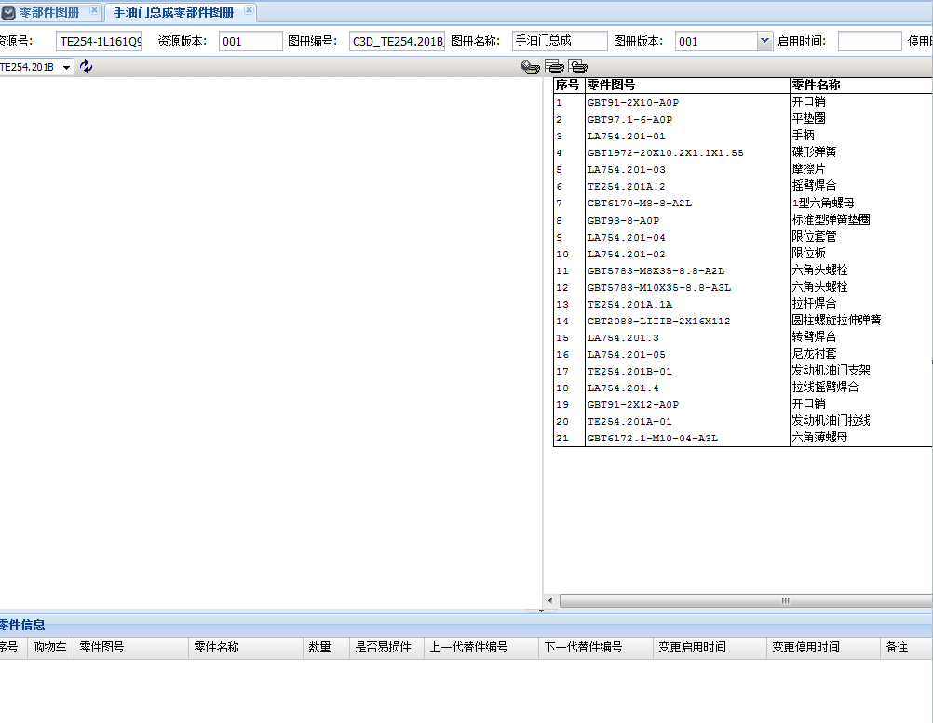
Chapter Ⅳ Solution of the frequent questions
Ⅰ 、The explosion diagram does not display
Example: open a resource, the explosion diagram shows blank, however, the schedule is normal.
Reason: not installed 2 D plug-in.
Solution: see the fourth quarter of the first part "2 D plug-in installation"
It shows blank

Slide 32
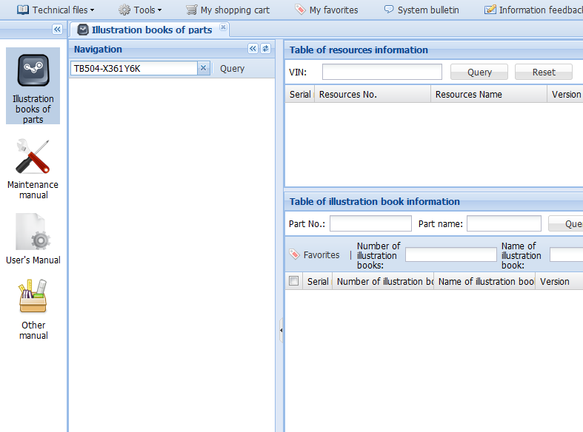
Chapter Ⅳ Solution of the frequent questions
Ⅱ 、Resource search is empty
Example: input TB504 - X361Y6K, does not find out the resource.
Reason: the resource is untapped so that search result is empty.
Solution: contact part business personnel, apply to develop the model.
Search result is blank

Slide 33
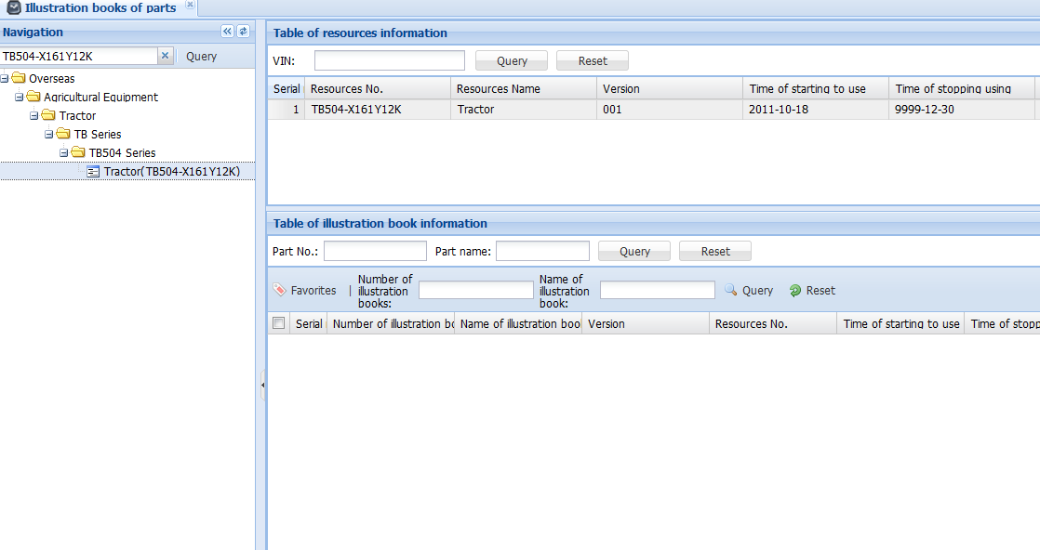
Chapter Ⅳ Solution of the frequent questions
Ⅲ 、Level 1 assembly displays empty
Example: input TB504 - X161Y12K, find out the resources, but not show the next lower level assembly resource.
Reason: there may be some problems in the resource popularization so that search result is empty.
Solution: contact part business personnel, at the same time, please provide resource, level 1 assembly number,
and problem screenshot, in order to solve the problem.
Search result shows normally
Search result shows normally
It shows blank

Slide 34
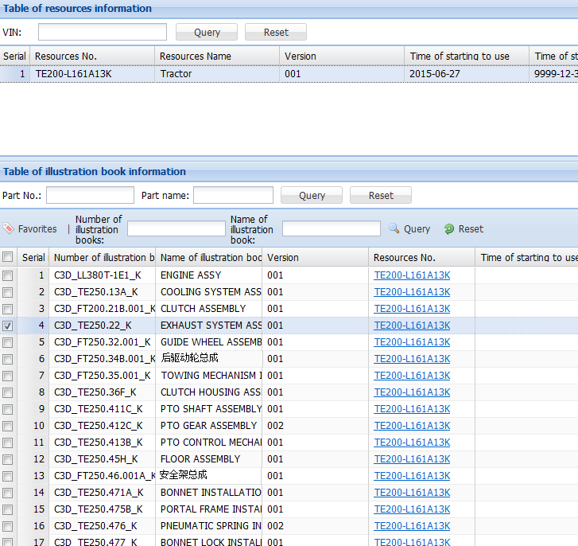
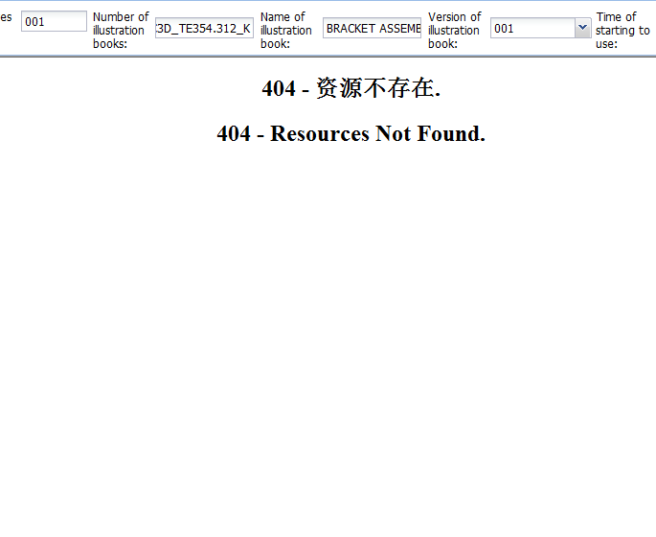
Chapter Ⅳ Solution of the frequent questions
Ⅳ 、It shows a Chinese name
Example: input TE200 - L161A13K, find out the resource, but the name of the resource at the next lower
level assembly includes a Chinese name.
Reason: the resource did not be promoted English atlas.
Solution: contact part business personnel, at the same time, please provide resource, level 1 assembly number,
and problem screenshot, in order to solve the problem.
There are some wrong data.
Introductions：
This phenomenon results from English atlas which not be promoted, but it belongs to the normal phenomenon. Encounter such a problem, please give a feedback to parts business personnel in time, management personnel by the background will provide solution in a timely way.

Slide 35
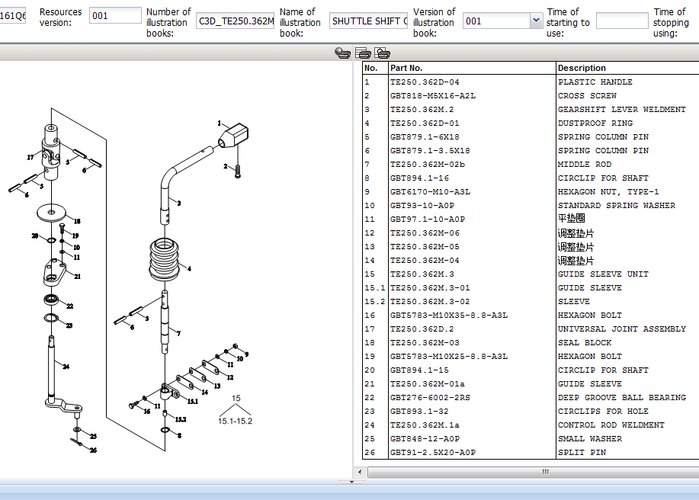
Chapter Ⅳ Solution of the frequent questions
Ⅴ 、There are Chinese names in parts atlas.
Example: input TE354-1L161Q6K, find out the resource, but the explosion diagram of resources atlas in detail
under inclusion has a Chinese name.
Reason: the atlas appear omissions when promoting English atlas, need to push again.
Solution: contact part business personnel, at the same time, please provide resource, level 1 assembly number,
and problem screenshot, in order to solve the problem.
There are some wrong data.

Slide 36
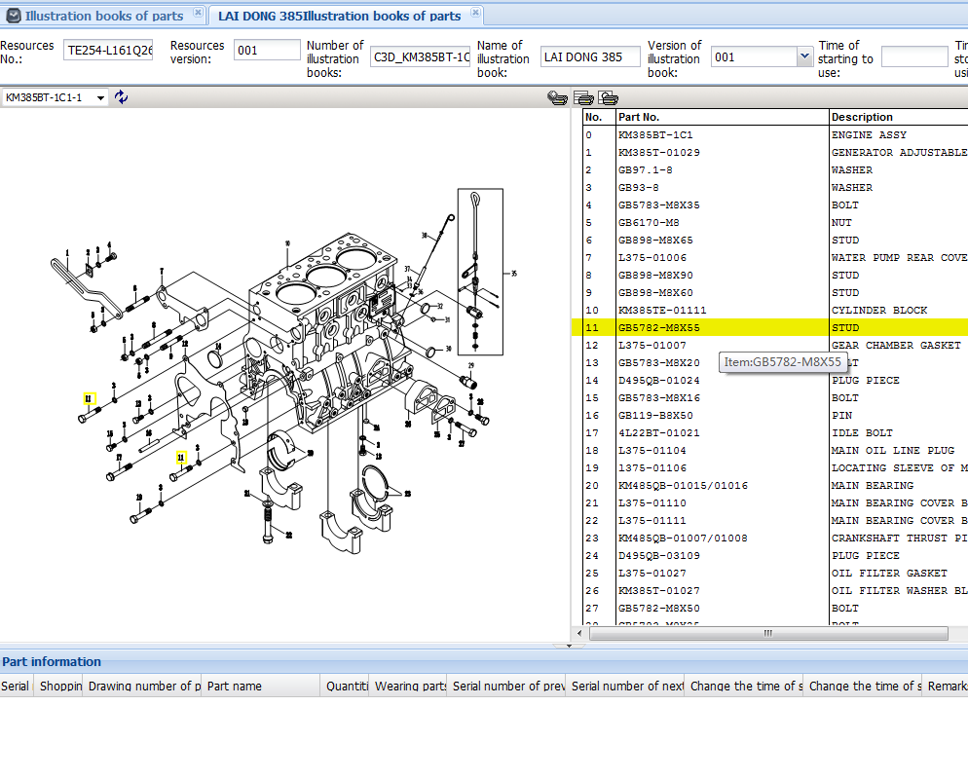
Chapter Ⅳ Solution of the frequent questions
Ⅵ 、Can not submit parts
Example: input TE254 - L161Q26K, required parts can’t be added to shopping cart.
Reason: 1. The data is not sales, without the scope of procurement; 2. The data has a problem and need a feedback.
Solution: contact part business personnel to carry out the kind of parts to solve the problem.
Double-click the fittings is invalid, cannot show below.
Did not display the data.

Slide 37
